Slide 2
上课内容：自然拼读
上课时间：每周六晚19：00 - 20：30
上课老师：尹岩老师

Slide 4
A is for apple [æ] [æ] [æ]
B is for bat [b] [b] [b]
C is for cat [k] [k] [k]
D is for dog [d] [d] [d]
E is for elephant [e] [e] [e]
F is for frog [f] [f] [f]
G is for girl [g] [g] [g]

Slide 5
H is for head [h] [h] [h]
I is for it [i] [i] [i]
J is for jug [dʒ] [dʒ] [dʒ]
K is for kite [k] [k] [k]
L is for lion [l] [l] [l]
M is for monkey [m] [m] [m]
N is for nose [n] [n] [n]

Slide 6
O is for orange [ɔ][ɔ][ɔ]
P is for pear [p] [p] [p]
Q is for queen [kw] [kw] [kw]
R is for rain [r] [r] [r]
S is for sweet [s] [s] [s]
T is for tiger [t] [t] [t]

Slide 7
Uu
字母读音： [ju:]
字母发音： [ʌ]

Slide 8
U is for up [ʌ] [ʌ] [ʌ]
under
cup
umbrella

Slide 9
Vv
字母读音： [vi:]
字母发音： [v]

Slide 10
V is for five [v] [v] [v]
vet
five
violin

Slide 11
Ww
字母读音：['dʌbl ju:]
字母发音：[w]

Slide 12
W is for way [w] [w] [w]
watch
water
west

Slide 14
Xx
字母读音： [eks]
字母发音： [ks]

Slide 15
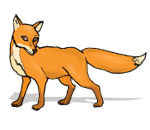
X is for box [ks] [ks] [ks]
box
fox
six

Slide 16
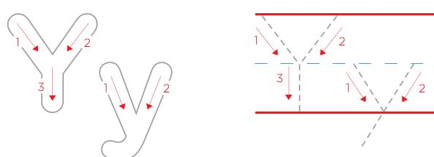
Yy
字母读音： [wai]
字母发音： [j]

Slide 17
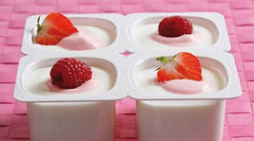
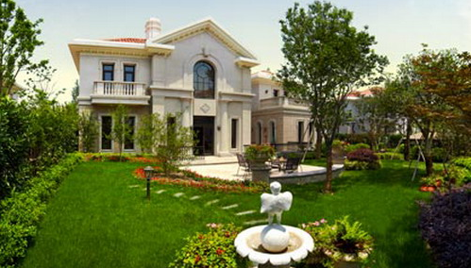
Y is for yes [ j ] [ j ] [ j ]
yellow
yoghurt
yard

Slide 18
Zz
字母读音：[zed] [zi:]
字母发音：[z]

Slide 19
Z is for zoo [ z ] [ z ] [ z ]
zoo
zebra
zero

Slide 20
U is for up [ʌ] [ʌ] [ʌ]
V is for five [v] [v] [v]
W is for way [w] [w] [w]
X is for box [ks] [ks] [ks]
Y is for yes [ j ] [ j ] [ j ]
Z is for zoo [ z ] [ z ] [ z ]

