Slide 3
上课内容：自然拼读
上课时间：每周六晚19：00 - 20：30
上课老师：尹岩老师

Slide 4
自然拼读:
自然拼读法又称“Phonics”， 它不仅是以英语为母语国家的孩子学习英语读音与拼字，增进阅读能力与理解力的教学法，更是以英语为第二语言的英语初学者学习发音规则与拼读技巧的教学方法。

Slide 5
Aa
字母读音： [ei]
字母发音： [æ]

Slide 6
A is for apple [æ] [æ] [æ]
apple
cat
hat

Slide 7
Bb
字母读音： [bi:]
字母发音： [b]

Slide 8
B is for bat [b] [b] [b]
ball
balloon
bus

Slide 9
Cc
字母读音： [si:]
字母发音： [k]

Slide 10
C is for cat [k] [k] [k]
cake
cap
car

Slide 11
Dd
字母读音： [di:]
字母发音： [d]

Slide 12
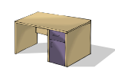
D is for dog [d] [d] [d]
desk
door
duck

Slide 14
Ee
字母读音： [i:]
字母发音： [e]

Slide 15
E is for elephant [e] [e] [e]
bed
egg
elephant

Slide 16
Ff
字母读音： [ef]
字母发音： [f]

Slide 17
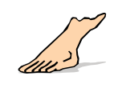
F is for frog [f] [f] [f]
fish
flower
foot

Slide 18
Gg
字母读音： [dʒi:]
字母发音： [g]

Slide 19
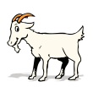
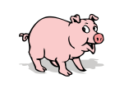
G is for girl [g] [g] [g]
goat
guitar
pig

Slide 20
A is for apple [æ] [æ] [æ]
B is for bat [b] [b] [b]
C is for cat [k] [k] [k]
D is for dog [d] [d] [d]
E is for elephant [e] [e] [e]
F is for frog [f] [f] [f]
G is for girl [g] [g] [g]

